Slide 1

INSTITUTE UIE
DEPARTMENT ACADEMIC UNIT-1
Bachelor of Engineering (Computer Science & Engineering)
Subject Name Introduction Electrical & Electronics Engineering
Subject Code- 23ECH-101
Prepared By
Dr. Shikha
Unit-1 Chapter-2
Introduction of Electrical & Electronics Circuit
Lecture No. 1.2.4
Logic Gates
DISCOVER . LEARN . EMPOWER

Slide 2
Lecture Objectives
S. No. | Objectives
1 | To make student aware about different logic gates
2 | To impart knowledge about realizing a logic function using gates.
3 | To make and understand of deriving basic gates from universal gates.

Slide 3
Course Objectives
S. No. | Objectives
1 | Understand Electrical & Electronics Engineering Fundamentals
2 | To prepare students to perform the analysis and design of various Electrical & digital electronic circuits.

Slide 4
Course Outcomes
CO Number | Title | Level
CO1 | To identify the different types of electrical elements and the basic op-amp circuit elements and to illustrate the various types of motors, transducers. | Remember
CO2 | To understand basic principles of transformers, transducers, op-amps, DC and AC motors and to compare the different methods for analysing electrical and magnetic circuits. | Understand
CO3 | To derive the relationships between parameters in electric and magnetic circuits and motors and to determine specifications of op-amps. | Analyze
CO4 | To solve the basic problems related to electric circuits, magnetic circuits and motors and to assess the characteristics of different configurations of op-amps. | Evaluate
CO5 | To design the different applications of transducers, motors as well as the op-amps like adders, subtractor and comparators. | Create

Slide 5
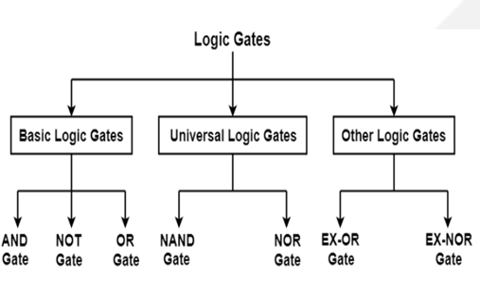

LOGIC GATES
Logic gates
Realization of circuit using gates
Figure 1.2 Classification of logic Gates [5]

Slide 6
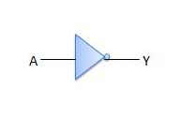

NOT LOGIC GATE
NOT gate has only one input and one output
IC used for two input NOT gate is 7404 .
Figure 1.5 Symbol of NOT gate [12 ]
Figure 1.6 NOT GATE[2]
Boolean Expression : Y = Aꞌ
A (input) | Y (output)
0 | 1
1 | 0
Truth Table of NOT gate

Slide 7


AND LOGIC GATE
And gate has n no. Of inputs and one output whereas in the symbol there are only two inputs.
IC used for two input AND gate is 7408 .
A (input) | B(input) | Y (output)
0 | 0 | 0
0 | 1 | 0
1 | 0 | 0
1 | 1 | 1
Figure 1.3 Symbol of AND gate [12]
Boolean Expression : Y=A.B
Truth Table of AND gate

Slide 8

OR LOGIC GATE
OR gate has n no. Of inputs and one output whereas in the symbol there are only two inputs.
IC used for two input OR gate is 7432 .
A (input) | B(input) | Y (output)
0 | 0 | 0
0 | 1 | 1
1 | 0 | 1
1 | 1 | 1
Figure 1.4 Symbol of OR gate [12 ]
Boolean Expression : Y=A + B
Truth Table of OR gate

Slide 9

NAND LOGIC GATE
NAnd gate has n no. Of inputs and one output whereas in the symbol there are only two inputs.
IC used for two input NAND gate is 7400 .
A (input) | B(input) | C (output)
0 | 0 | 1
0 | 1 | 1
1 | 0 | 1
1 | 1 | 0
Figure 1.6 Symbol of NAND gate [12 ]
Boolean Expression : Y= A.B
Truth Table of NAND gate

Slide 10

NOR LOGIC GATE
NOR gate has n no. Of inputs and one output whereas in the symbol there are only two inputs.
IC used for two input NOR gate is 7402 .
A (input) | B(input) | Y (output)
0 | 0 | 1
0 | 1 | 0
1 | 0 | 0
1 | 1 | 0
Figure 1.7 Symbol of NOR gate [12 ]
Boolean Expression : Y= A + B
Truth Table of NOR gate

Slide 11

EX-OR LOGIC GATE
XOR gate has n no. Of inputs and one output whereas in the symbol there are only two inputs.
IC used for two input XOR gate is 7486 .
A (input) | B(input) | Y (output)
0 | 0 | 0
0 | 1 | 1
1 | 0 | 1
1 | 1 | 0
Figure 1.8 Symbol of XOR gate [12 ]
Boolean Expression : Y=A B
⊕
Truth Table of XOR gate

Slide 12
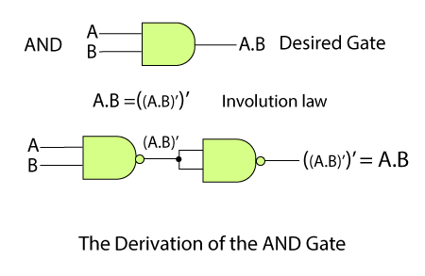
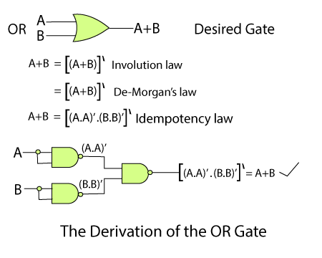
BASIC GATES FROM UNIVERSIAL GATES
AND gate using NAND gate
OR gate using NAND gate.
Figure 1.9 conversion of AND gate from NAND Gate [8]
Figure 1.10 conversion of OR gate from NAND Gate [8]

Slide 13
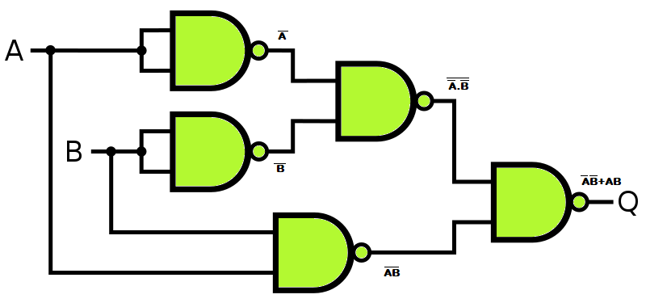
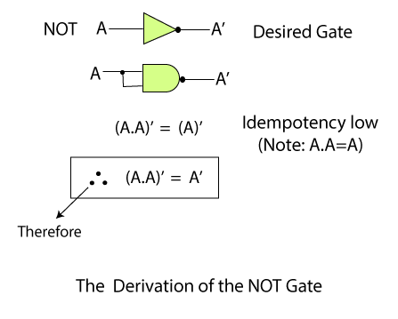
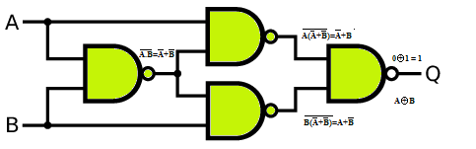
BASIC GATES FROM UNIVERSIAL GATES
NOT gate using NAND gate
XNOR gate using NAND gate
Figure 1.12 conversion of XNOR gate from NAND Gate [8]
XNOR gate using NAND gate
Figure 1.11 conversion of NOT gate from NAND Gate [8]
Figure 1.9 conversion of XOR gate from NAND Gate [8]

Slide 14
APPLICATIONS
Computers
Calculators
ATM
Mobile Phone
Integrated Circuits and so on......

Slide 15

REFERENCES
https://www.vivaxsolutions.com/physics/allogicgates.aspx
https://www.androiderode.com/ttl-not-gate/
Mano,Morris, Digital Design, Prentice Hall of India.
Fletcher, An Engg. Approach to digital design, Prentice Hall of India.
http://www.geeksforgeeks.org/digital-electronics-logic-design-tutorials/
http://www.ni.com/example/14493/en/
http://195.134.76.37/applets/AppletGates/Appl_Gates2.html
https://www.javatpoint.com/and-gate-in-digital-electronics
https://www.allaboutcircuits.com/textbook/digital/
https://www.tutorialspoint.com/digital_electronics/index.asp
https://www.tutorialspoint.com/computer_logical_organization/complement_arithmetic.htm

Slide 16
THANK YOU

